Slide 1
Agenda
10 - 11am
Intro to SQL
11am - 12pm
Begin exploring SQL Project
12 - 1pm
Prof. Nader on Security
1pm - 2:30pm
Break
2:30 - 4:30pm
Complete SQL Project

Slide 2
Introduction to SQL

Slide 3
Outline
What is a Database?
What is SQL?
When do you need a Database?
Uses of Databases
Relational Databases Concepts
Finding Your Way Around the Server
Variable Types
SQL Basics
NoSQL
SQL vs. NoSQL

Slide 4

You’ve reinvented the retail experience

Slide 5
You’ve convinced an investor to give you $1M

Slide 6
You’ve found the perfect location

Slide 7
You’ve designed it flawlessly

Slide 8
You’re ready to begin accepting customers

Slide 9
Wait… How the heck are we gonna keep track of everything?
You’re ready to begin accepting customers

Slide 10
Wait… How the heck are we gonna keep track of everything?
Inventory, employees, customers, purchases?
You’re ready to begin accepting customers

Slide 11
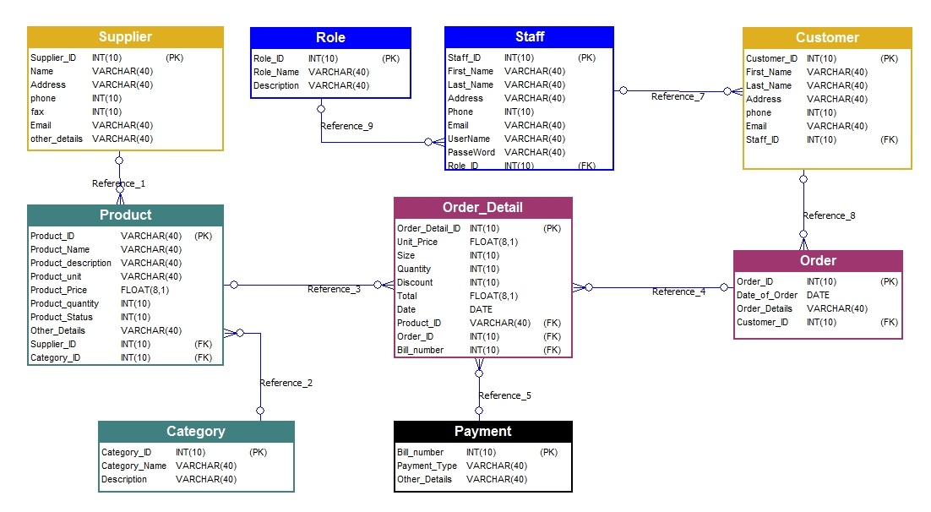
The Answer? Data!

Slide 12

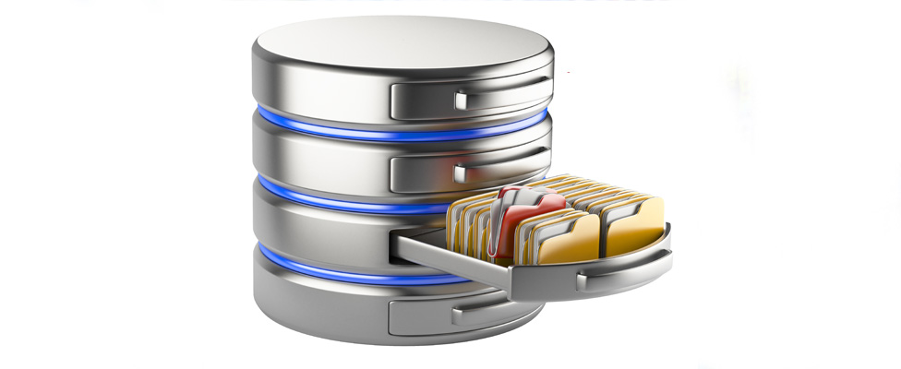
What is a Database?
An organized collection of structured information, or data, typically stored electronically in a computer system
Controlled by a database management system (DBMS)

Slide 13

When do you need a Database?
Simultaneous access + updates (concurrency)
Frequent updates
Share huge data set among many people
Fast analytical queries
Web interfaces to data, especially dynamic data

Slide 14

Uses of Databases
Databases are used for storage, where data is extracted and analyzed in other applications. Key parts of backends to web sites. Some examples:
Netflix
Show availability, User Ratings, User Viewing History
NBA
Store and analyze player statistics, game performances, injury reports
eBay
Organize products, pricing, customer information, and purchasing history

Slide 15

What is SQL?
Structured Query Language
Used to “talk” to a database server
Declarative
Tell me what you want, I’ll figure out how to get it

Slide 16
Relational Databases Concepts
A database server can contain many databases
Databases are collections of tables
Each tables is a 2D matrix with rows (entries) and columns (fields)
SQL is great at combining information across tables

Slide 17
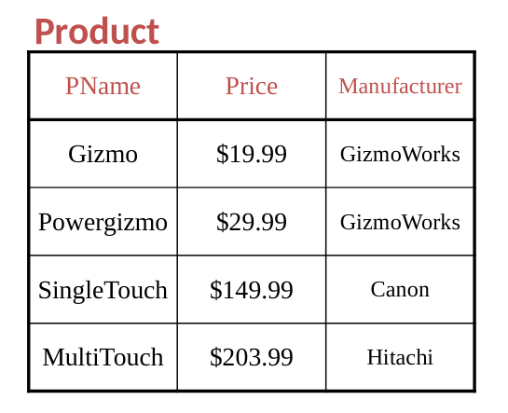
Relational Databases Concepts
Tables are two-dimensional with rows (observations) and columns (variables)

Slide 18
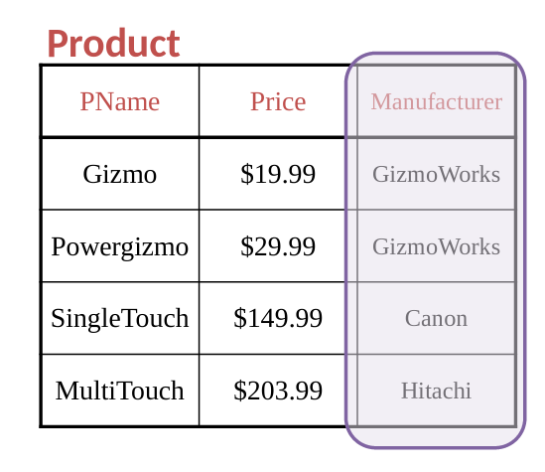
Relational Databases Concepts
Tables are two-dimensional with rows (observations) and columns (variables)

Slide 19
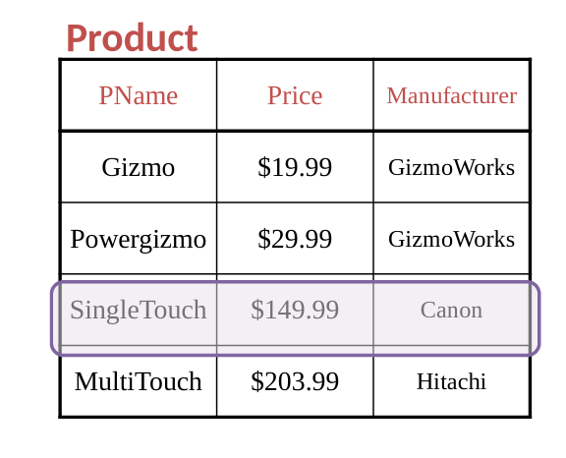
Relational Databases Concepts
Tables are two-dimensional with rows (observations) and columns (variables)

Slide 20
SQL Basics - Finding Your Way Around the Server
A single server can support many databases, each containing many tables, with each table having a variety of columns.
These commands will help figure out what’s available:
SHOW DATABASES;
SHOW TABLES IN database;
SHOW COLUMNS IN table;
DESCRIBE table;- shows the columns and their types

Slide 21
SQL Basics - Variable Types
Numeric
INTEGER, SMALLINT, BIGINT
NUMERIC(w,d), DECIMAL(w,d)- numbers with width w and d decimal places
REAL, DOUBLE PRECISION- machine and database dependent
FLOAT(p)- floating point number with p binary digits of precision

Slide 22
SQL Basics - Variable Types
Character
CHARACTER(L)- a fixed-length character of length L
CHARACTER VARYING(L) or VARCHAR(L)- supports maximum length of L Binary
BIT(L), BIT VARYING(L)- like corresponding characters
BINARY LARGE OBJECT(L) or BLOB(L)
Temporal
DATE
TIME, TIMESTAMP

Slide 23
SQL Basics - Create a Table
Suppose we have data of the length, weight and age of books over a range of genres.
We can create a table with the next command:
CREATE TABLE books(id INT,
title VARCHAR(255),
age INT,
pages INT,
weight DECIMAL(7,3),
genre CHAR(1));

Slide 24
SQL Basics - Create a Table
CREATE TABLE books(id INT,
title VARCHAR(255),
age INT,
pages INT,
weight DECIMAL(7,3),
genre CHAR(1));
books
id | title | age | pages | weight | genre

Slide 25
SQL Basics - Insert Data
Enter individual items with the next command:
INSERT INTO books VALUES(100011,”The Caterpillar”,10,148,38.95,”M”);
books
id | title | age | pages | weight | genre
100011 | The Caterpillar | 10 | 148 | 38.95 | M

Slide 26
SQL Basics - Insert Data
We can automate the process using the next command:
LOAD DATA INFILE ‘books.tab’
INTO TABLE books
FIELDS TERMINATED BY ’\t’;
This will read an entire tab-separated file into the database in one command.

Slide 27
SQL Basics - SELECT Operator
Select some subset of the variables and/or observations from a table (read values from table)
SELECT columns or computations FROM table
WHERE condition
GROUP BY columns
HAVING condition
ORDER BY column [ASC | DESC]
LIMIT offset,count;

Slide 28
SQL Basics - SELECT Operator
Key
You have the next table:
books
id | title | age | pages | weight | genre
100011 | The Caterpillar | 10 | 148 | 38.95 | M
100012 | Art of War | 15 | 157 | 45.2 | F
100013 | To Kill a Mockingbird | 27 | 144 | 22.11 | Q
100014 | An Apple | 44 | 189 | 74.8 | M
100015 | The Unbearable Lightness of Being | 7 | 166 | 54.32 | F
100016 | One Hundred Years of Solitude | 8 | 120 | 89.1 | F

Slide 29
SQL Basics - SELECT Operator
SELECT * FROM books;
id | title | age | pages | weight | genre
100011 | The Caterpillar | 10 | 148 | 38.95 | M
100012 | Art of War | 15 | 157 | 45.2 | F
100013 | To Kill a Mockingbird | 27 | 144 | 22.11 | Q
100014 | An Apple | 44 | 189 | 74.8 | M
100015 | The Unbearable Lightness of Being | 7 | 166 | 54.32 | F
100016 | One Hundred Years of Solitude | 8 | 120 | 89.1 | F

Slide 30
SQL Basics - Comparison Operators
The WHERE clause allows you to operate on subsets of a table. The following comparison operators are available:
Usual logical operators:< > <= >= = <>
BETWEEN used to test for a range
IN used to test group membership
Keyword NOT used for negation
LIKE operator allows wildcards
_means single character, % means anything
SELECT salary WHERE name LIKE ’Fred %’;
Use AND(&&) and OR(||) to combine conditions

Slide 31
SQL Basics - SELECT Operator
Find the age, name, height and weight for any books with weight greater than 30 kg and pages less than 150:
SELECT title,age,pages,weight FROM books
WHERE weight > 30 AND pages < 150;
title | age | pages | weight
The Caterpillar | 10 | 148 | 38.95
One Hundred Years of Solitude | 8 | 120 | 89.1

Slide 32
SQL Basics - SELECT Operator
Find all different genres present in the table books:
SELECT DISTINCT genre FROM books;
genre
M
F
Q

Slide 33
SQL Basics - SELECT Operator
Find all information about the 3 books with the most pages:
SELECT * FROM books
ORDER BY pages DESC LIMIT 3;
id | title | age | pages | weight | genre
100014 | An Apple | 44 | 189 | 74.8 | M
100015 | The Unbearable Lightness of Being | 7 | 166 | 54.32 | F
100012 | Art of War | 15 | 157 | 45.2 | F

Slide 34
SQL Basics - SELECT Operator
Find all information about observations where age is from 8 to 18 and the number of pages goes from 140 to 160:
SELECT * FROM books WHERE age BETWEEN 8 AND 18
AND pages BETWEEN 140 AND 160;
id | title | age | pages | weight | genre
100011 | The Caterpillar | 10 | 148 | 38.95 | M
100012 | Art of War | 15 | 157 | 45.2 | F

Slide 35
SQL Basics - UPDATE Operator
To change some of the values of columns of a table, you can use the UPDATE command.
To add one to the weight of an observation to the books table where age is between 8 and 11, we could use:
UPDATE books SET weight=weight + 1
WHERE age BETWEEN 8 and 11;

Slide 36
SQL Basics - UPDATE Operator
UPDATE books SET weight=weight + 1
WHERE age BETWEEN 8 and 11;
id | title | age | pages | weight | genre
100011 | The Caterpillar | 10 | 148 | 39.95 | M
100012 | Art of War | 15 | 157 | 45.2 | F
100013 | To Kill a Mockingbird | 27 | 144 | 22.11 | Q
100014 | An Apple | 44 | 189 | 74.8 | M
100015 | The Unbearable Lightness of Being | 7 | 166 | 54.32 | F
100016 | One Hundred Years of Solitude | 8 | 120 | 90.1 | F

Slide 37
SQL Basics - Arithmetic Operators
Basic arithmetic operations to create new columns
COUNT()
AVG()(mean)
SUM()
MIN()
MAX()
Find max. pages for age between 10 and 30 and genre M:
SELECT MAX(pages) AS Maximum_Pages FROM books
WHERE age BETWEEN 10 AND 30 AND genre = “M” ;
Maximum_Pages
148

Slide 38
SQL Basics - Arithmetic Operators
Count the number of books in the database with a specific genre:
SELECT COUNT(*) as Number_Books, genre FROM books
GROUP BY genre;
Number_Books | genre
2 | M
3 | F
1 | Q

Slide 39
SQL Basics - Arithmetic Operators
When using aggregate functions, conditions can’t be used in the WHERE clause, they must be placed in the HAVING clause.
Count the number of books in the database with a specific genre, and show only those groups with more than one book:
SELECT COUNT(*) as Number_Books, genre FROM books
GROUP BY genre HAVING COUNT(*) > 1;
Number_Books | genre
2 | M
3 | F

Slide 40
SQL Basics - Subqueries
By putting a SELECT statement in parentheses, you can use it in other SELECT statements as if it were another table.
SELECT * FROM books
WHERE id IN
(SELECT id FROM books
WHERE weight < 80 AND pages < 150 AND age < 20);
id | title | age | pages | weight | genre
100011 | The Caterpillar | 10 | 148 | 38.95 | M

Slide 41
SQL Basics - Multiple Tables
OrderID | CustomerID | OrderDate
10308 | 2 | 1996-09-18
10309 | 37 | 1996-09-19
10310 | 1 | 1996-09-20
CustomerID | CustomerName | ContactName | Country
1 | Alfreds Futterkiste | Maria Anders | Germany
2 | Ana Trujillo Emparedados y helados | Ana Trujillo | Mexico
3 | Antonio Moreno Taquería | Antonio Moreno | Mexico

Slide 42
SQL Basics - Multiple Tables
SELECT Orders.OrderID, Customers.CustomerName, Orders.OrderDate
FROM Orders
INNER JOIN Customers
ON Orders.CustomerID=Customers.CustomerID;
OrderID | CustomerName | OrderDate
10308 | Ana Trujillo Emparedados y helados | 1996-09-18
10310 | Alfreds Futterkiste | 1996-09-20

Slide 43
SQL Basics - Multiple Tables (aliases)
SELECT o.OrderID, c.CustomerName, o.OrderDate
FROM Orders o
INNER JOIN Customers c
ON o.CustomerID=c.CustomerID;
OrderID | CustomerName | OrderDate
10308 | Ana Trujillo Emparedados y helados | 1996-09-18
10310 | Alfreds Futterkiste | 1996-09-20

Slide 44
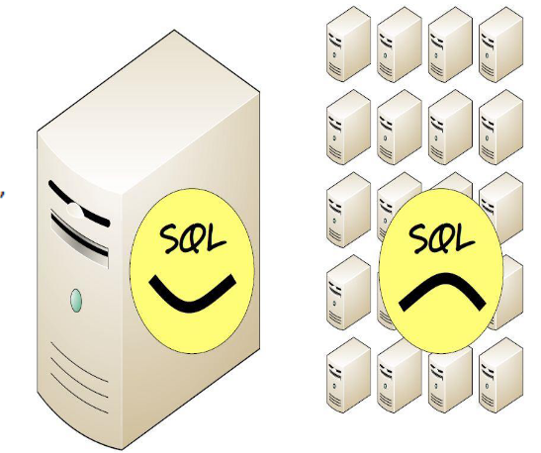
NoSQL - Why?
Relational databases were not built for distributed applications.
Joins are expensive
Hard to scale horizontally
Expensive (product cost, hardware, Maintenance)
It’s weak in:
Speed (performance)
High availability
Partition tolerance

Slide 45
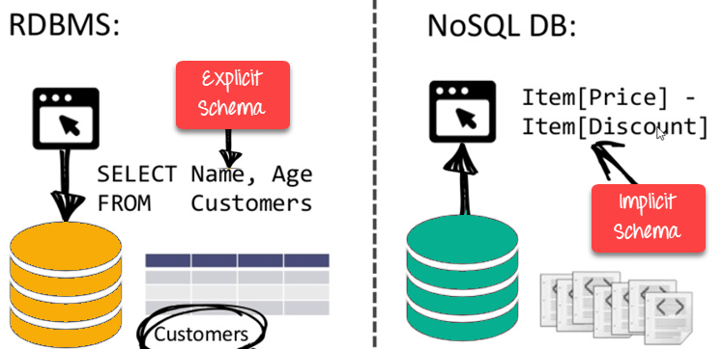
NoSQL - What is it?
Provides a mechanism for storage and retrieval of data that employs less constrained consistency models.
Flexible data models
Horizontal scaling as opposed to vertical (migrate to a larger, more expensive server)
Fast queries
Easy for developers

Slide 46
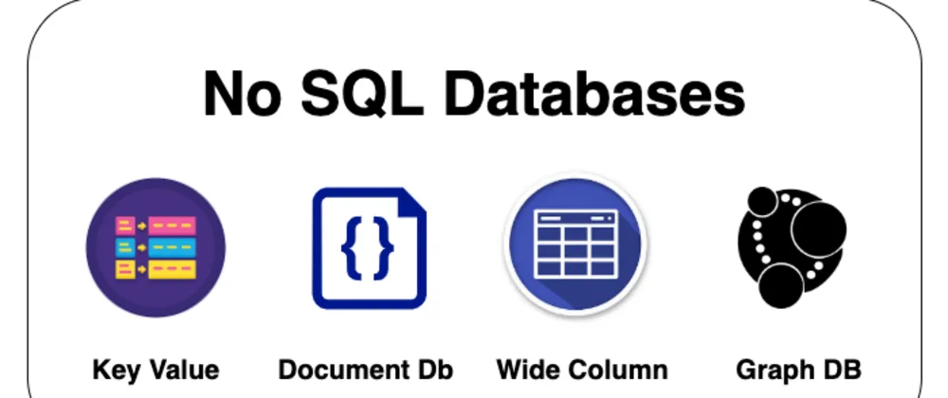
NoSQL - Types
NoSQL databases are classified in four major datamodels:
Key-value
Document
Column family
Graph

Slide 47
NoSQL - Types
NoSQL databases are classified in four major datamodels:
Key-value
Document
Column family
Graph

Slide 48
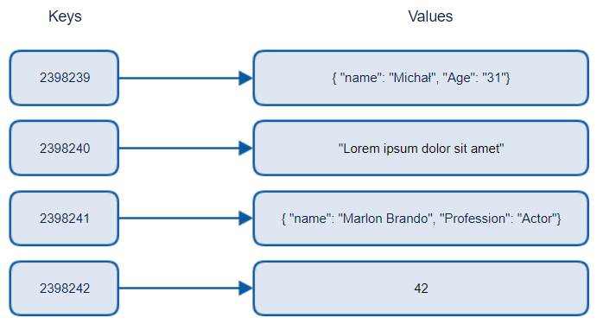
NoSQL - Types
NoSQL databases are classified in four major datamodels:
Key-value

Slide 49
SQL vs. NoSQL
 | SQL Databases | NoSQL Databases
Data Storage Model | Tables with fixed rows and columns | Document: JSON documents, Key-value: key-value pairs, Wide-column: tables with rows and dynamic columns, Graph: nodes and edges
Development History | Developed in the 1970s with a focus on reducing data duplication | Developed in the late 2000s with a focus on scaling and allowing for rapid application change driven by agile and DevOps practices.
Examples | Oracle, MySQL, Microsoft SQL Server, and PostgreSQL | Document: MongoDB and CouchDB, Key-value: Redis and DynamoDB, Wide-column: Cassandra and HBase, Graph: Neo4j and Amazon Neptune

Slide 50
SQL vs. NoSQL
 | SQL Databases | NoSQL Databases
Primary Purpose | General purpose | Document: general purpose, Key-value: large amounts of data with simple lookup queries, Wide-column: large amounts of data with predictable query patterns, Graph: analyzing and traversing relationships between connected data
Schemas | Rigid | Flexible
Scaling | Vertical (scale-up with a larger server) | Horizontal (scale-out across commodity servers)
Joins | Typically required | Typically not required

Slide 51
SQL Project
5 Tables: orders, items, categories, order_items, item_categories

Slide 52
SQL Project
5 Tables: orders, items, categories, order_items, item_categories
This is real (anonymized) data.

Slide 53
SQL Project
5 Tables: orders, items, categories, order_items, item_categories
id | user | time
10308 | 9410624108399432229 | 2020-07-11 19:07:00
10365 | 12885036321172598371 | 2020-07-12 10:52:00
10383 | 9410624108399432229 | 2020-07-13 12:05:00
10355 | 12885036321172598371 | 2020-07-14 1:11:10
10278 | 9410624108399432229 | 2020-07-15 17:47:18

Slide 54
SQL Project
5 Tables: orders, items, categories, order_items, item_categories
id | name | price
1 | Eggs | 269
2 | White Bread | 299
3 | 2% Milk | 299
4 | Toilet Paper | 899
5 | Haagen-Dazs, Vanilla | 599

Slide 55
SQL Project
5 Tables: orders, items, categories, order_items, item_categories
id | main | sub
1 | Groceries | Dairy & Eggs
2 | Groceries | Bakery & Bread
3 | Household | Cleaning Supplies
4 | Ice Cream | Haagen-Dazs
5 | Ice Cream | Ben & Jerry’s

Slide 56
SQL Project
5 Tables: orders, items, categories, order_items, item_categories
oid | pid | qty
1000 | 1 | 1
1000 | 4 | 1
1001 | 1 | 2
1001 | 3 | 1
1001 | 5 | 3

Slide 57
SQL Project
5 Tables: orders, items, categories, order_items, item_categories
pid | cid
1 | 1
2 | 2
2 | 20
3 | 2
4 | 3

Slide 58
SQL Project
5 Tables: orders, items, categories, order_items, item_categories
orders
id
items
id
categories
id
order_items
pid
oid
item_categories
pid
cid

Slide 59
SQL Project
https://colab.research.google.com/drive/1T2L3HTImYOrIZPpUYmRqwiA0bCOZmvDu?usp=sharing
https://drive.google.com/file/d/1kaAJ2BOvDzyl_gXf2RtbaHIsVkNA4yDC/view?usp=sharing

